Slide 1
ELASTICITY OF DEMAND
Ms. Maria Alzira Xavier
Assistant Professor
Basic Sciences and Humanities Department

Slide 2
Elasticity of Demand
The quantity demanded for some commodities are more responsive to
a given change in price than the quantity demanded of other goods.
In other words, the demand for certain goods are more elastic than demands of other goods.
“The elasticity of demand in a market is great or small according as the amount demanded increases much or little for a given fall in the price and diminishes much or little for a given rise in price”. – Prof. Alfred Marshall
Today, we have concepts of price elasticity, income elasticity, cross
elasticity and substitution elasticity.

Slide 3
1. Price Elasticity of Demand
measures the responsiveness of demand to a change in price.
Inelastic – a change in price causes a smaller % change in demand.
Elastic – a change in price causes a bigger % change in demand.

Slide 4
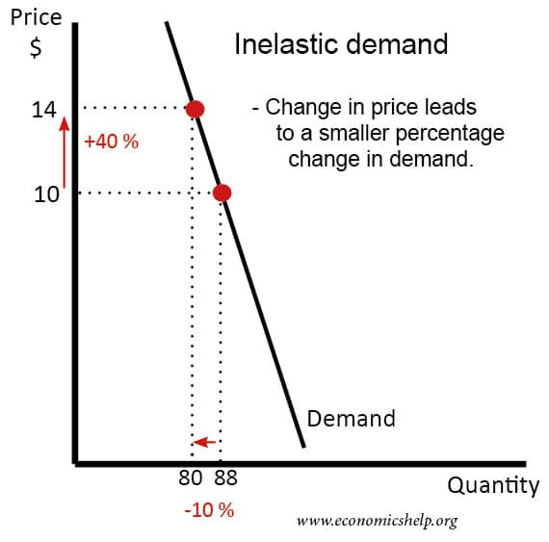
We say a good has an inelastic demand, when an increase in price causes a smaller % fall in demand, e.g. if price of petrol rises 40%, but demand for petrol only falls 10%.

Slide 5
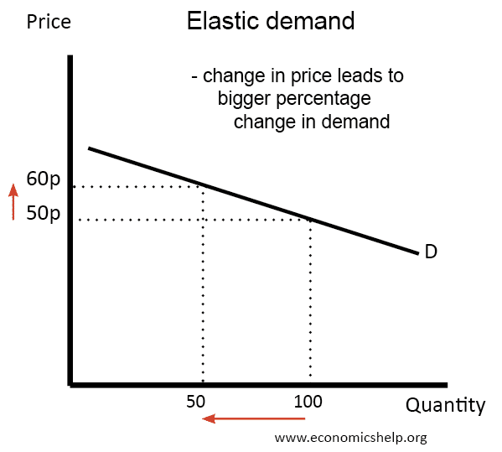
We say a good has an elastic demand when an increase in prices causes a bigger % fall in demand. e.g. if price rises 20% and demand falls 50%.

Slide 6
Price elasticity of demand depends on various factors:
Necessities v/s luxury
Availability of close substitutes
Time horizon (urgency of demand)
Proportion of income spent on the commodity
Income level

Slide 7
Examples of products having a inelastic demand
Salt. If the price of salt increases, demand would largely be unchanged.
Tap water. For householders, tap water is a necessity with no alternatives.
Diamonds. Bought very infrequently, diamonds are the ultimate luxury with few exact alternatives.
Peak rail tickets. For commuters who rely on the train to get to work in London/Mumbai, demand will be very inelastic.
Cigarettes. If cigarette tax increases and the price of all tobacco increases, demand will be inelastic because many smokers are addicted and don’t have any alternatives to keep buying.
Apple iPhones, iPads. The Apple brand is so strong that many consumers will pay a premium for Apple products. If the price rises for Apple iPhone, many will continue to buy.

Slide 8
Examples of products having a elastic demand:
Newspaper. If the Navhind Times increases its price, there are similar newspapers people will switch to. For example, o Herald.
Kit Kat chocolate bar. If Kit Kats increase, people will switch to alternative types of a chocolate bar.
Porsche sports car. If a Porsche increases in price, demand will probably be elastic because it is a high % of income, and so the higher price will put people off. Also, there are other alternatives, such as Jaguar or Aston Martin. However, this is a little less clear cut. Some car enthusiasts may want to buy a Porsche whatever the price.

Slide 9

1. Price elasticity:
It is the ratio of proportionate changes in the quantity demanded of a commodity to a given proportionate change in its prices. It is the ratio of a relative change in quantity to a relative change in price.
Percentage Method:
Where:
= Q2 – Q1 = P2 – P1
Q2 = New quantity demanded P2 = New price
Q1(or Q) = Original quantity demanded P1 (or P) = Original price

Slide 10
Thus, if the price of a commodity falls from Rs.100 to Rs. 90 and this leads to an increase in quantity demanded from 200 units to 240 units, price elasticity of demand would be calculated as follows:

Slide 11
Q1(or Q) = 200 units P1 (or P) = Rs. 100
Q2 = 240 units P2 = Rs. 90
Therefore:
= Q2 – Q1 = 240 – 200 = 40 units
= P2 – P1 = 90 – 100 = - (Rs.10)

Slide 12
40 / 200
40
* 100
e(p) =
200
=
-10 / 100
-10
e(p) =
−2
=
−2
e(p) =
2

Slide 13
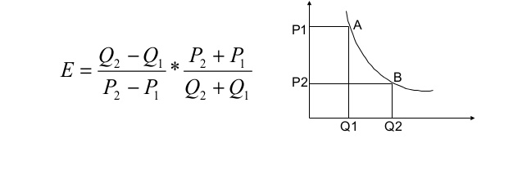
ARC ELASTICITY OF DEMAND
Arc elasticity is defined as the elasticity between two points on a curve.

Slide 14
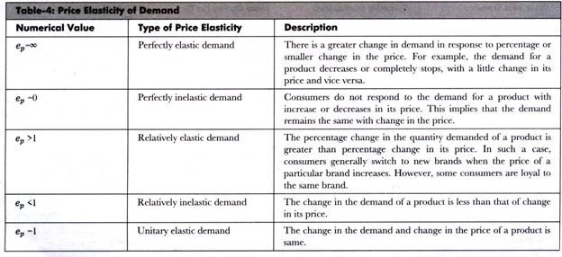
Classification of Price elasticity of Demand

Slide 15
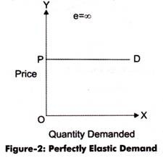
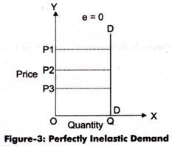
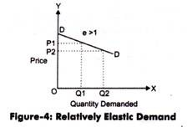
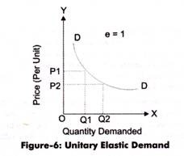
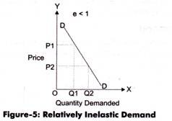

Slide 16




Price
Perfectly Elastic
(PED= ∞)
Elastic
(PED=>1)
D
Point 3
Unit Elastic (PED=1)
Inelastic (PED<1)
Point 2
Perfectly Inelastic (PED=0)
D
Quantity Demanded
Point 1

Slide 17
2. Income Elasticity of Demand
  Income elasticity of demand shows the extent to which a consumer’s demand for that commodity changes as a result of changes in his income.
The ratio of proportionate change in the quantity demanded of the commodity to a given proportionate change in the income of the consumer.
Income % Change in the Quantity Demanded of a Commodity ^{Elasticity =} % Change in the Level of Income of a Consumer
_{Ey =} dQ / Q ₌ dQ * Y dy / Y dY Q

Slide 18
The Engel Curve
The Engel curve, named after the German statistician Ernst Engel (1821-96), is a relation be­tween the demand for a good and the income of its buyers, the former depending on the latter.
For an Engel Curve income is shown on the X-axis and Quantity Demanded on the Y-axis.

Slide 19
The Engel curve for an inferior good (X or Y) would be bending to the horizontal axis because after a certain level, as income rises, the consumer reduces the purchase of the good.

Slide 20
On the other hand, there are some goods (e.g., food) the consumer’s purchase of which increases less than proportionately as his money income rises. For such a good, his Engel curve would be upward sloping.
Quantity Demanded
Income

Slide 21
Lastly, the consumer increases the demand for some goods (luxury items) more than proportionately as his money income rises. The Engel curve for such a good will be upward sloping.

Slide 22
3. Cross Elasticity of Demand
The two goods can either be substitutes of each other, or complementary to each other, or completely independent of each other.
The ratio of proportionate change in the quantity demanded of a commodity
to a given proportionate change in the price of the related commodity.
Cross Elasticity
₌ % Change in the Quantity Demanded of a Commodity ‘a’
% Change in the Price of Related Commodity ‘b’
ΔQa Pb
^{Ec =} ΔPb * Qa

Slide 23
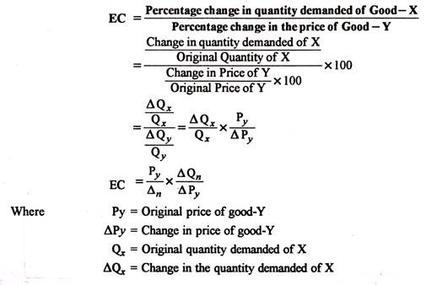

Slide 24
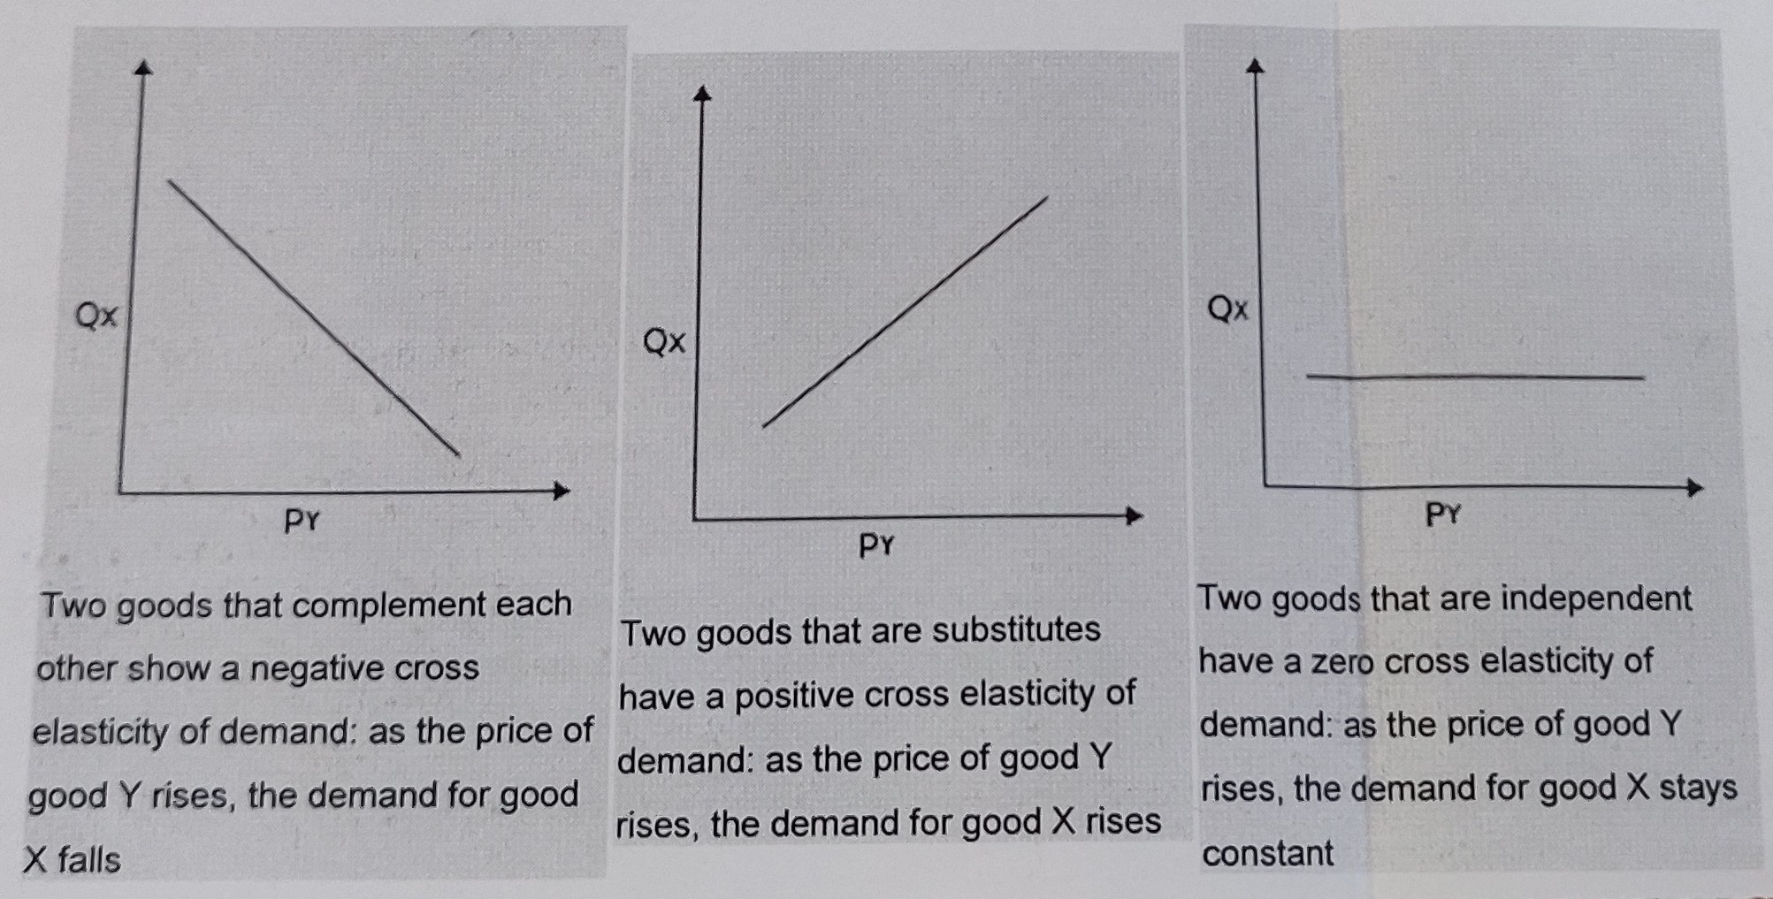

Slide 25
Elasticity of Supply

Slide 26
Elasticity of Supply
Elasticity of Supply is the responsiveness of quantity supplied to a change in the price.
It is given by the formula:
+ e_{s} = ∆Qs. P
∆P Qs
Usually the elasticity of supply is a positive number, showing a positive response of quantity supplied to a change in the price.

Slide 27
Types of S-elasticities
1. Elastic supply: Rate of increase in Qs > rate of
increase in P. (e_{s} > 1)
Supply responds at a rate greater than rate of change in P. Goods whose supply can easily increase, or are available in stock.
A price elasticity supply greater than 1 means supply is relatively elastic, where the quantity supplied changes by a larger percentage than the price change.
S
Rs
b
P1
a
P0
S
0
Q0
Q1
Qs

Slide 28
2. Inelastic supply:
Qs responds at a rate lower than change in price. (e_{s} < 1)
Goods needing more time for production, or low stocks have inelastic supply.
Rs
S
P1
b
a
P0
0
S
Q0 Q1
Qs

Slide 29
3. Unitary elasticity: e_{s} = 1, and quantity supplied responds at the same rate as change in price.
Rs
S
b
P1
a
P0
0
Q0
Q1
Qs

Slide 30
4. Perfectly inelastic: There is no response of Qs to ∆P. (e_{s} = 0)
S
P1
b
Rs
P0
a
0
S
Qs

Slide 31
5. Perfectly Elastic Supply
The PES for perfectly elastic supply is infinite, where the quantity supplied is unlimited at a given price, but no quantity can be supplied at any other price. There are virtually no real-life examples of this, where even a small change in price would dissuade, or disallow, product makers from supplying even a single product.
Rs
S
P0
0
Qs

Slide 32
ELASTICITY AND ITS APPLICATIONS.
Eg. Effects of Changes in Price on Quantity Demanded:
The concept is very useful to study the reactions of the demand for a commodity to the changes in its price.
If the demand is elastic - a small change in the price brings about a considerable change in the quantity demanded
If the demand is inelastic – for a small change in the price, the corresponding change in demand is considerably small.
Hence, the concept is relevant to the decisions relating to business pricing and profits.

Slide 33
Eg 1. Calculate price elasticity of demand
Commodity | Original Price | New Price | Original Demand | New Demand
X | 10 | 11 | 50 | 45
Y | 2 | 12 | 10 | 8
Z | 90 | 92 | 40 | 35

Slide 36
Eg 2 Find price elasticity of demand
Price per kg (Rs.) | Total Expenditure
3 | 20,000
5 | 15,000
7 | 7,000
10 | 5,000

Slide 38
Eg 3 Compute income elasticity of demand
Gopal demand 4kgs of sugar per month, when his income is Rs. 20,000. When his income went up to Rs. 24,000, he raised the demand of sugar to 5 kgs per month. Find income elasticity of demand.

